Slide 1

Elsenima Website Redesign
Presented by: Ahmed Siddig Abdelwahab

Slide 2

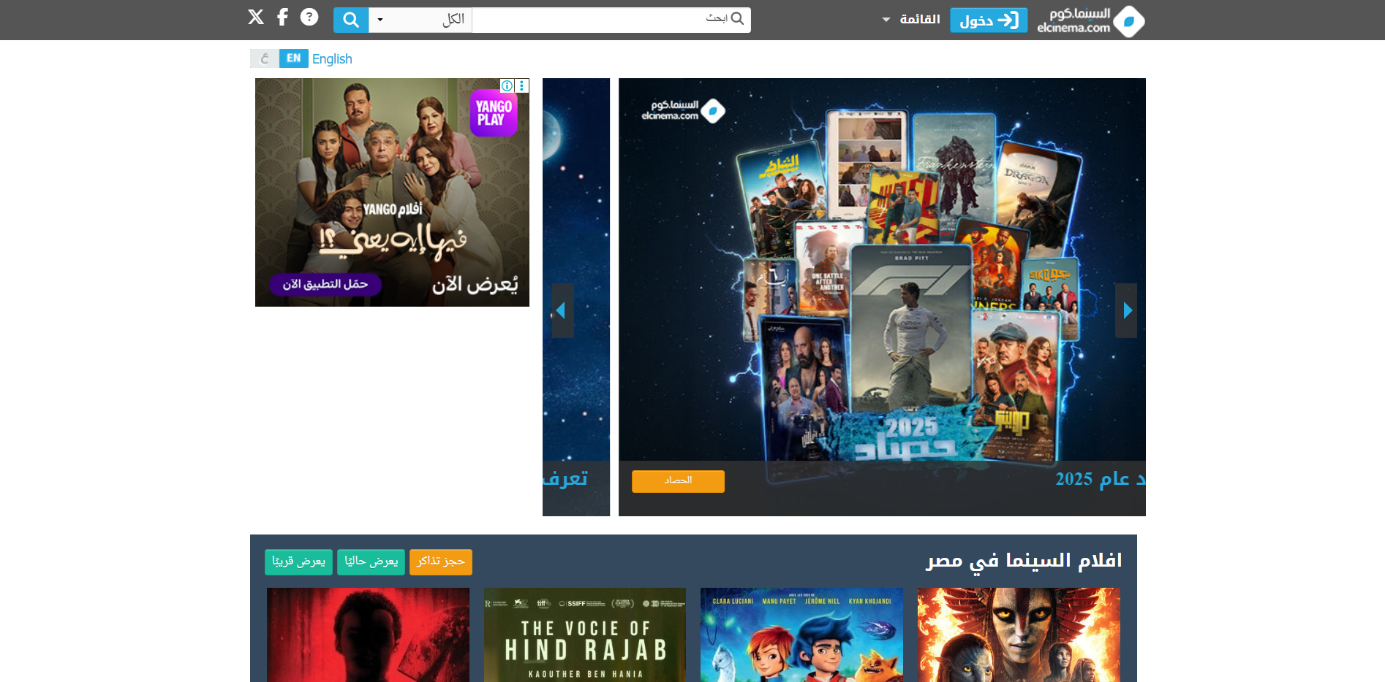
The Problems in the original design first page:
1. The page suffers from visual clutter due to the large number of elements displayed at the same time.
2. The primary user goal is not clearly defined, making it difficult for users to know where to start.
3. The visual hierarchy is weak, which affects content readability and user focus.
4. The use of multiple inconsistent colors reduces clarity and visual consistency.

Slide 3
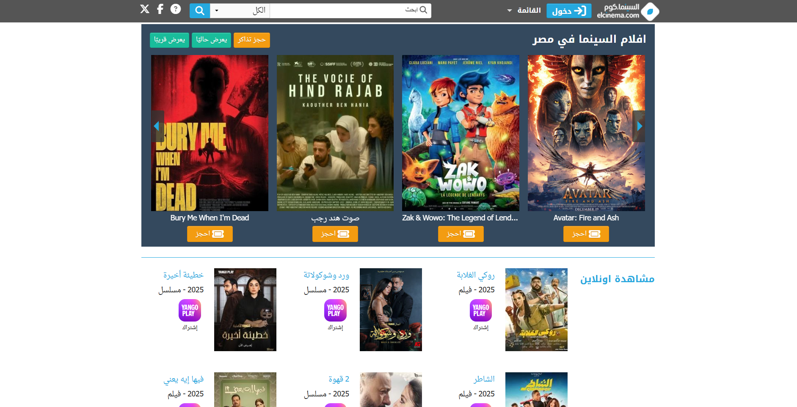
The Problems in the original design second page:
1. There is no clear prioritization between movie categories, which makes content scanning difficult.
2. Movie cards contain inconsistent layouts and information density.
3. Action buttons are small and lack strong visual emphasis.

Slide 4
Redesign Goals & Objectives: Create a modern and visually consistent cinema themed interface Improve clarity and readability through better layout and spacing Highlight key actions such as searching, filtering, and booking tickets Enhance location-based usability by helping users find nearby cinemas Provide a smoother and more intuitive user journey from browsing to booking

Slide 5
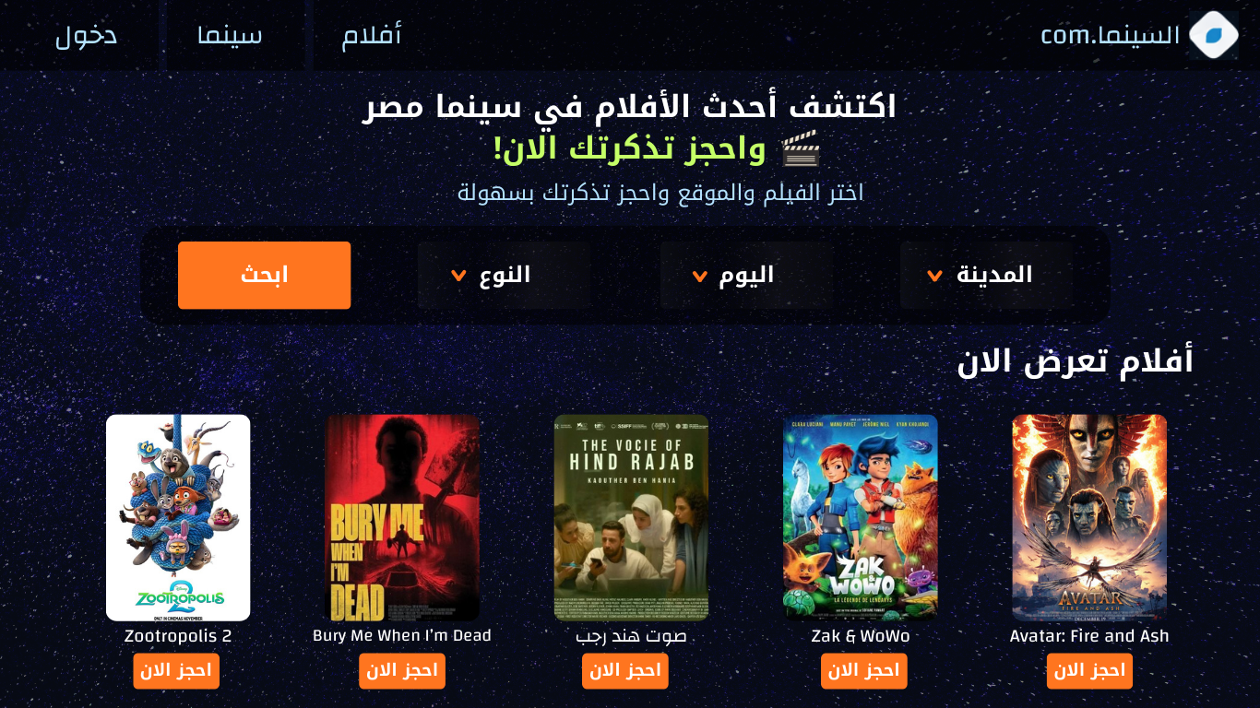
Design Improvements in the redesigned first page:
1. A clear hero section to define the main purpose of the website.
2. A dark cinematic color scheme to create visual consistency and improve focus.
3. Call-to-action button to highlight searching and booking actions.
4. Search and filter options (city, date, genre) grouped into a single, clear section.

Slide 6
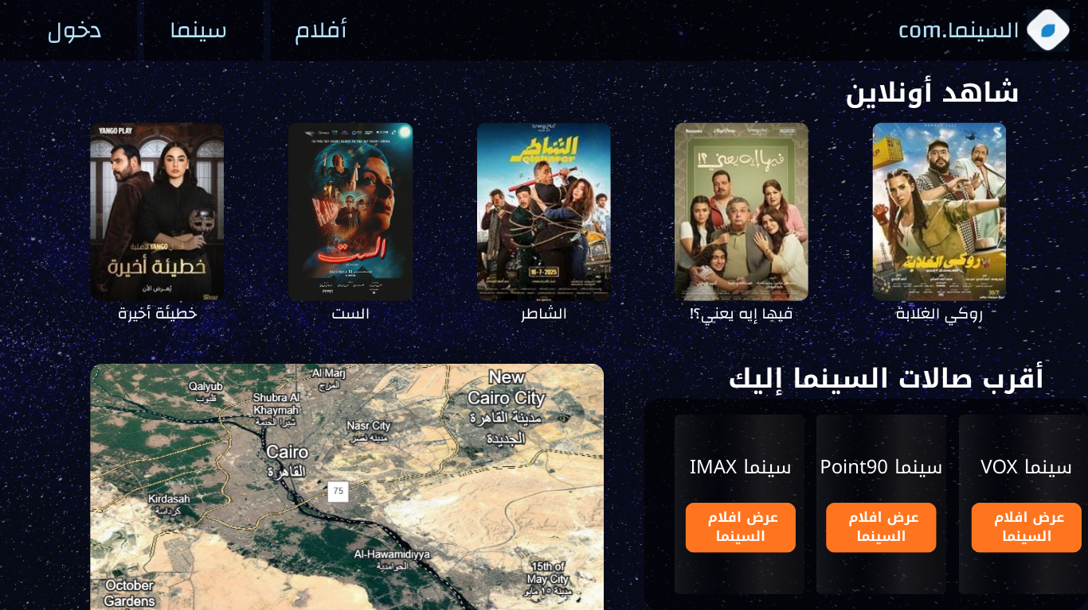
Design Improvements in the redesigned second page:
1. A map-based section to help users easily locate nearby cinemas.
2. Cinema options in structured cards with clear labels and actions.
3. Clear action buttons improve visibility.

Slide 7
Thank You

